Slide 1
Algorithms
Dynamic programming

Slide 2
Dynamic Programming
Another strategy for designing algorithms is dynamic programming
  A metatechnique, not an algorithm
  (like divide & conquer)
  The word “programming” is historical and predates computer programming
Use when problem breaks down into recurring small subproblems

Slide 3
Dynamic programming
It is used, when the solution can be recursively described in terms of solutions to subproblems (optimal substructure)
Algorithm finds solutions to subproblems and stores them in memory for later use
More efficient than “brute-force methods”, which solve the same subproblems over and over again

Slide 4
A framework to solve Optimization problems
For each current choice:
  Determine what subproblem(s) would remain if this choice were made.
  Recursively find the optimal costs of those subproblems.
  Combine those costs with the cost of the current choice itself to obtain an overall cost for this choice
Select a current choice that produced the minimum overall cost.

Slide 5
Elements of Dynamic Programming
Constructing solution to a problem by building it up dynamically from solutions to smaller (or simpler) sub-problems
  sub-instances are combined to obtain sub-instances of increasing size, until finally arriving at the solution of the original instance.
  make a choice at each step, but the choice may depend on the solutions to sub-problems
Principle of optimality
  the optimal solution to any nontrivial instance of a problem is a combination of optimal solutions to some of its sub-instances.
Memoization (for overlapping sub-problems)
  avoid calculating the same thing twice,
  usually by keeping a table of know results that fills up as sub-instances are solved.

Slide 6
Development of a dynamic programming algorithm
Characterize the structure of an optimal solution
  Breaking a problem into sub-problem
  whether principle of optimality apply
Recursively define the value of an optimal solution
  define the value of an optimal solution based on value of solutions to sub-problems
Compute the value of an optimal solution in a bottom-up fashion
  compute in a bottom-up fashion and save the values along the way
  later steps use the save values of pervious steps
Construct an optimal solution from computed information

Slide 7
Example
Fibonacci numbers:
0, 1, 1, 2, 3, 5, 8, 13, 21, 24
Recurrence Relation of Fibonacci numbers?

Slide 8
Example: Fibonacci numbers
Recall definition of Fibonacci numbers:
  f(0) = 0
  f(1) = 1
  f(n) = f(n-1) + f(n-2) for n ≥ 2
Computing the n^{th} Fibonacci number recursively (top-down): f(n)
f(n-1) + f(n-2)
f(n-2) + f(n-3) f(n-3) + f(n-4)
...

Slide 9
Fib vs. fibDyn
int fib(int n) {
if (n <= 1) return n; // stopping conditions
else return fib(n-1) + fib(n-2); // recursive step
}
int fibDyn(int n, vector<int>& fibList) {
int fibValue;
if (fibList[n] >= 0) // check for a previously computed result and return
return fibList[n];
// otherwise execute the recursive algorithm to obtain the result
if (n <= 1) // stopping conditions
fibValue = n;
else // recursive step
fibValue = fibDyn(n-1, fibList) + fibDyn(n-2, fibList);
// store the result and return its value
fibList[n] = fibValue;
return fibValue;
}

Slide 10
Example: Fibonacci numbers
  Computing the n^{th} fibonacci number using bottom-up iteration:
f(0) = 0
f(1) = 1
f(2) = 0+1 = 1
f(3) = 1+1 = 2
f(4) = 1+2 = 3
f(5) = 2+3 = 5
f(n-2) = f(n-3)+f(n-4)
f(n-1) = f(n-2)+f(n-3)
f(n) = f(n-1) + f(n-2)

Slide 11
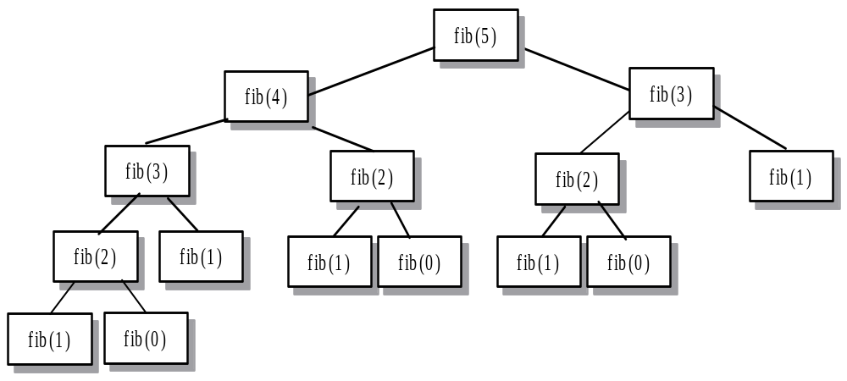
Recursive calls for fib(5)

Slide 12
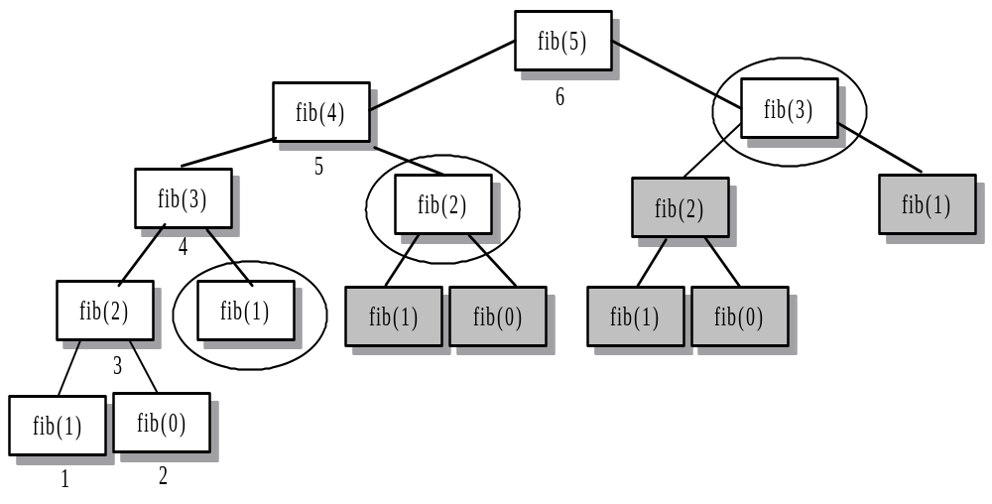
fib(5) Using Dynamic Programming

Slide 13
FiboDP(n):
F[0]¬ 0
F[1] ¬1
for i=2 to n do
F[i]¬F[i-1]+F[i-2]
endfor
return(F[n])

Slide 14
FiboDP(n):
Prev= 0
Curr=1
for i=2 to n do
Temp=curr
Curr=curr+prev
Prev=temp
endfor
return(curr)

Slide 15
Longest Common Subsequence (LCS)
Application: comparison of two DNA strings
Ex: X= {A B C B D A B }, Y= {B D C A B A}
Longest Common Subsequence:
X = A B C B D A B
Y = B D C A B A
Brute force algorithm would compare each subsequence of X with the symbols in Y

Slide 16
LCS Algorithm
if |X| = m, |Y| = n, then there are 2^{m} subsequences of x; we must compare each with Y (n comparisons)
So the running time of the brute-force algorithm is O(n 2^{m})
Notice that the LCS problem has optimal substructure: solutions of subproblems are parts of the final solution.
Subproblems: “find LCS of pairs of prefixes of X and Y”

Slide 17

LCS Algorithm
First we’ll find the length of LCS. Later we’ll modify the algorithm to find LCS itself.
Define X_{i}, Y_{j} to be the prefixes of X and Y of length i and j respectively
Define c[i,j] to be the length of LCS of X_{i} and Y_{j}
Then the length of LCS of X and Y will be c[m,n]

Slide 18
LCS recursive solution
We start with i = j = 0 (empty substrings of x and y)
Since X₀ and Y₀ are empty strings, their LCS is always empty (i.e. c[0,0] = 0)
LCS of empty string and any other string is empty, so for every i and j: c[0, j] = c[i,0] = 0

Slide 19
LCS recursive solution
When we calculate c[i,j], we consider two cases:
First case: x[i]=y[j]: one more symbol in strings X and Y matches, so the length of LCS X_{i} and Y_{j} equals to the length of LCS of smaller strings X_{i-1} and Y_{i-1} , plus 1

Slide 20
LCS recursive solution
Second case: x[i] != y[j]
As symbols don’t match, our solution is not improved, and the length of LCS(X_{i} , Y_{j}) is the same as before (i.e. maximum of LCS(X_{i}, Y_{j-1}) and LCS(X_{i-1},Y_{j})

Slide 21
LCS Length Algorithm
LCS-Length(X, Y)
1. m = length(X) // get the # of symbols in X
2. n = length(Y) // get the # of symbols in Y
3. for i = 1 to m c[i,0] = 0 // special case: Y₀
4. for j = 1 to n c[0,j] = 0 // special case: X₀
5. for i = 1 to m // for all X_{i}
6. for j = 1 to n // for all Y_{j}
7. if ( X_{i} == Y_{j} )
8. c[i,j] = c[i-1,j-1] + 1
9. else c[i,j] = max( c[i-1,j], c[i,j-1] )
10. return c

Slide 22
LCS Example
We’ll see how LCS algorithm works on the following example:
X = ABCB
Y = BDCAB
What is the Longest Common Subsequence
of X and Y?
LCS(X, Y) = BCB
X = A B C B
Y = B D C A B

Slide 23
LCS Example (0)
ABCB
BDCAB
j 0 1 2 3 4 5
i
Yj
B
D
C
A
B
0
Xi
A
1
2
B
3
C
4
B
X = ABCB; m = |X| = 4
Y = BDCAB; n = |Y| = 5
Allocate array c[5,4]

Slide 24
LCS Example (1)
ABCB
BDCAB
j 0 1 2 3 4 5
i
Yj
B
D
C
A
B
0
Xi
0
0
0
0
0
0
A
1
0
2
B
0
3
C
0
4
B
0
for i = 1 to m c[i,0] = 0
for j = 1 to n c[0,j] = 0

Slide 25
LCS Example (2)
ABCB
BDCAB
j 0 1 2 3 4 5
i
Yj
B
D
C
A
B
0
Xi
0
0
0
0
0
0
A
1
0
0
2
B
0
3
C
0
4
B
0
if ( X_{i} == Y_{j} )
c[i,j] = c[i-1,j-1] + 1
else c[i,j] = max( c[i-1,j], c[i,j-1] )

Slide 26
LCS Example (3)
ABCB
BDCAB
j 0 1 2 3 4 5
i
Yj
B
D
C
A
B
0
Xi
0
0
0
0
0
0
A
1
0
0
0
0
2
B
0
3
C
0
4
B
0
if ( X_{i} == Y_{j} )
c[i,j] = c[i-1,j-1] + 1
else c[i,j] = max( c[i-1,j], c[i,j-1] )

Slide 27
LCS Example (4)
ABCB
BDCAB
j 0 1 2 3 4 5
i
Yj
B
D
C
A
B
0
Xi
0
0
0
0
0
0
A
1
0
0
0
0
1
2
B
0
3
C
0
4
B
0
if ( X_{i} == Y_{j} )
c[i,j] = c[i-1,j-1] + 1
else c[i,j] = max( c[i-1,j], c[i,j-1] )

Slide 28
LCS Example (5)
ABCB
BDCAB
j 0 1 2 3 4 5
i
Yj
B
D
C
A
B
0
Xi
0
0
0
0
0
0
A
1
0
0
0
0
1
1
2
B
0
3
C
0
4
B
0
if ( X_{i} == Y_{j} )
c[i,j] = c[i-1,j-1] + 1
else c[i,j] = max( c[i-1,j], c[i,j-1] )

Slide 29
LCS Example (6)
ABCB
BDCAB
j 0 1 2 3 4 5
i
Yj
B
D
C
A
B
0
Xi
0
0
0
0
0
0
A
1
0
0
0
0
1
1
2
B
0
1
3
C
0
4
B
0
if ( X_{i} == Y_{j} )
c[i,j] = c[i-1,j-1] + 1
else c[i,j] = max( c[i-1,j], c[i,j-1] )

Slide 30
LCS Example (7)
ABCB
BDCAB
j 0 1 2 3 4 5
i
Yj
B
D
C
A
B
0
Xi
0
0
0
0
0
0
A
1
0
0
0
0
1
1
2
B
0
1
1
1
1
3
C
0
4
B
0
if ( X_{i} == Y_{j} )
c[i,j] = c[i-1,j-1] + 1
else c[i,j] = max( c[i-1,j], c[i,j-1] )

Slide 31
LCS Example (8)
ABCB
BDCAB
j 0 1 2 3 4 5
i
Yj
B
D
C
A
B
0
Xi
0
0
0
0
0
0
A
1
0
0
0
0
1
1
2
B
0
1
1
1
1
2
3
C
0
4
B
0
if ( X_{i} == Y_{j} )
c[i,j] = c[i-1,j-1] + 1
else c[i,j] = max( c[i-1,j], c[i,j-1] )

Slide 32
LCS Example (10)
ABCB
BDCAB
j 0 1 2 3 4 5
i
Yj
B
D
C
A
B
0
Xi
0
0
0
0
0
0
A
1
0
0
0
0
1
1
2
B
0
1
1
1
1
2
3
C
0
1
1
4
B
0
if ( X_{i} == Y_{j} )
c[i,j] = c[i-1,j-1] + 1
else c[i,j] = max( c[i-1,j], c[i,j-1] )

Slide 33
LCS Example (11)
ABCB
BDCAB
j 0 1 2 3 4 5
i
Yj
B
D
C
A
B
0
Xi
0
0
0
0
0
0
A
1
0
0
0
0
1
1
2
B
0
1
1
1
1
2
3
C
0
1
1
2
4
B
0
if ( X_{i} == Y_{j} )
c[i,j] = c[i-1,j-1] + 1
else c[i,j] = max( c[i-1,j], c[i,j-1] )

Slide 34
LCS Example (12)
ABCB
BDCAB
j 0 1 2 3 4 5
i
Yj
B
D
C
A
B
0
Xi
0
0
0
0
0
0
A
1
0
0
0
0
1
1
2
B
0
1
1
1
1
2
3
C
0
1
1
2
2
2
4
B
0
if ( X_{i} == Y_{j} )
c[i,j] = c[i-1,j-1] + 1
else c[i,j] = max( c[i-1,j], c[i,j-1] )

Slide 35
LCS Example (13)
ABCB
BDCAB
j 0 1 2 3 4 5
i
Yj
B
D
C
A
B
0
Xi
0
0
0
0
0
0
A
1
0
0
0
0
1
1
2
B
0
1
1
1
1
2
3
C
0
1
1
2
2
2
4
B
0
1
if ( X_{i} == Y_{j} )
c[i,j] = c[i-1,j-1] + 1
else c[i,j] = max( c[i-1,j], c[i,j-1] )

Slide 36
LCS Example (14)
ABCB
BDCAB
j 0 1 2 3 4 5
i
Yj
B
D
C
A
B
0
Xi
0
0
0
0
0
0
A
1
0
0
0
0
1
1
2
B
0
1
1
1
1
2
3
C
0
1
1
2
2
2
4
B
0
1
1
2
2
if ( X_{i} == Y_{j} )
c[i,j] = c[i-1,j-1] + 1
else c[i,j] = max( c[i-1,j], c[i,j-1] )

Slide 37
LCS Example (15)
ABCB
BDCAB
j 0 1 2 3 4 5
i
Yj
B
D
C
A
B
0
Xi
0
0
0
0
0
0
A
1
0
0
0
0
1
1
2
B
0
1
1
1
1
2
3
C
0
1
1
2
2
2
4
B
3
0
1
1
2
2
if ( X_{i} == Y_{j} )
c[i,j] = c[i-1,j-1] + 1
else c[i,j] = max( c[i-1,j], c[i,j-1] )

Slide 38
LCS Algorithm Running Time
LCS algorithm calculates the values of each entry of the array c[m,n]
So what is the running time?
O(m*n)
since each c[i,j] is calculated in constant time, and there are m*n elements in the array

Slide 39
How to find actual LCS
So far, we have just found the length of LCS, but not LCS itself.
We want to modify this algorithm to make it output Longest Common Subsequence of X and Y
Each c[i,j] depends on c[i-1,j] and c[i,j-1]
or c[i-1, j-1]
For each c[i,j] we can say how it was acquired:
For example, here
c[i,j] = c[i-1,j-1] +1 = 2+1=3
2
2
2
3

Slide 40
How to find actual LCS - continued
Remember that
So we can start from c[m,n] and go backwards
Whenever c[i,j] = c[i-1, j-1]+1, remember x[i] (because x[i] is a part of LCS)
When i=0 or j=0 (i.e. we reached the beginning), output remembered letters in reverse order

Slide 41
Finding LCS
j 0 1 2 3 4 5
i
Yj
B
D
C
A
B
0
Xi
0
0
0
0
0
0
A
1
0
0
0
0
1
1
2
B
0
1
1
1
1
2
3
C
0
1
1
2
2
2
4
B
3
0
1
1
2
2

Slide 42
Finding LCS (2)
j 0 1 2 3 4 5
i
Yj
B
D
C
A
B
0
Xi
0
0
0
0
0
0
A
1
0
0
0
0
1
1
2
B
0
1
1
1
1
2
3
C
0
1
1
2
2
2
4
B
3
0
1
1
2
2
LCS (reversed order):
B
C
B
B C B
(this string turned out to be a palindrome)
LCS (straight order):

Slide 43
Assignment[Next class]
Define Dynamic programming
Explain Rod-cutting example with algorithm and analysis

